Slide 1
Supplier Engagement
Frankie Wallace
Supplier Engagement Lead

Slide 2
Updated Terms and Conditions of Contract
“Suppliers shall ensure full compliance with any Guidance issued by the Department of Health in relation to the adoption of GS1 and PEPPOL standards (to include, without limitation, any supplier compliance timeline and other policy requirements published by the Department of Health in relation to the adoption of GS1 and PEPPOL standards for master data provision and exchange, barcode labelling, and purchase-to-pay transacting).”

Slide 3
Key benefits to the NHS
Patient Safety
track and trace medicines and medical devices
rapid quarantine of products subject to a safety alert
targeted recall of patients impacted by product safety alerts
Release of clinical time to care
clinical productivity
automated inventory replenishment
Supply Chain efficiency
£480m recurring annual savings

Slide 4
Key benefits to suppliers
A single data source for product information
Reduced transaction costs
Greater efficiency and visibility of product throughout the supply chain
Reduced data management costs
Saving in time and increased efficiency and reliability in production, storage, picking, shipping and reporting through the use of barcode scanning
Aligned to legislation

Slide 5
Supplier engagement
Primarily via the trade associations
Medical and In-Vitro Diagnostic devices; Medicines; Office & IT; Estates & Facilities; Services
Adoption guidance and “10 Step Guide”
Distributors and wholesalers
Timelines for compliance and data attributes for both product and price
Supplier readiness questionnaire
Statement of Commitment
Self-declaration – twice yearly

Slide 6
Supplier requirements
Data
Data dictionaries for item and price attributes
61: 23 mandatory + 27 optional + 11 conditional mandatory (reduced from 97 mandatory)
Supplementary information describing data exchange process
Labelling
GS1 barcodes – device identifiers, production identifiers
Purchase-to-pay
Electronic exchange of orders and invoices with GS1
identifiers via PEPPOL

Slide 7
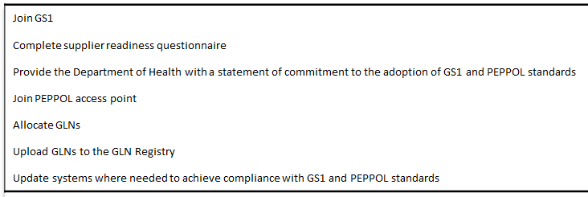
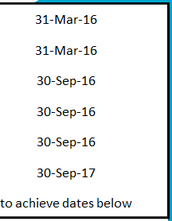
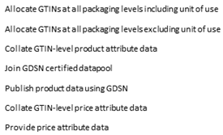
Join GS1 |  |  |  | 31-Mar-16
Complete supplier readiness questionnaire |  |  |  | 31-Mar-16
Provide the Department of Health with a statement of commitment to the adoption of GS1 and PEPPOL standards |  |  |  | 30-Sep-16
Join PEPPOL access point |  |  |  | 30-Sep-16
Allocate GLNs |  |  |  | 30-Sep-16
Upload GLNs to the GLN Registry |  |  |  | 30-Sep-17
Update systems where needed to achieve compliance with GS1 and PEPPOL standards |  |  |  | to achieve dates below
Medical Devices EU Classification | Class III | Class IIb | Class IIa | Class I
In-Vitro Diagnostic Devices EU Classification | IVD List A | IVD List B | IVD self-test | IVD General
Allocate GTINs at all packaging levels including unit of use | 30-Sep-16 | 30-Sep-17 | 30-Sep-17 | -
Allocate GTINs at all packaging levels excluding unit of use | - | - | - | 30-Sep-18
Collate GTIN-level product attribute data | 31-Mar-17 | 31-Mar-18 | 31-Mar-18 | 31-Mar-19
Join GDSN certified datapool | 31-Mar-17 | 31-Mar-18 | 31-Mar-18 | 31-Mar-19
Publish product data using GDSN | 30-Sep-17 | 30-Sep-18 | 30-Sep-18 | 30-Sep-19
Collate GTIN-level price attribute data | 31-Mar-18 | 31-Mar-19 | 31-Mar-19 | 31-Mar-20
Provide price attribute data | 30-Sep-18 | 30-Sep-19 | 30-Sep-19 | 30-Sep-20
Packaging label to carry GS1 GTIN barcode | 30-Sep-17 | 30-Sep-18 | 30-Sep-18 | 30-Sep-19
Packaging label to carry GS1 GTIN and production identifier barcodes | 30-Sep-18 | 30-Sep-19 | 30-Sep-19 | 30-Sep-20
Receive orders from NHS access points | 31-Mar-17 | 31-Mar-17 | 31-Mar-17 | 31-Mar-17
Send invoices to NHS access points | 30-Sep-17 | 30-Sep-17 | 30-Sep-17 | 30-Sep-17
Receive orders carrying GS1 GTIN and GLN data from NHS access points | 31-Mar-18 | 31-Mar-18 | 31-Mar-18 | 30-Sep-18
Send invoices carrying GS1 GTIN and GLN data to NHS access points | 30-Sep-18 | 30-Sep-18 | 30-Sep-18 | 31-Mar-19

Slide 8
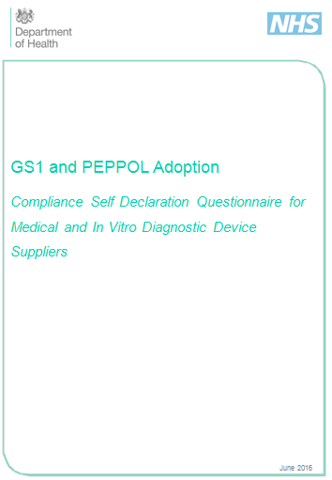
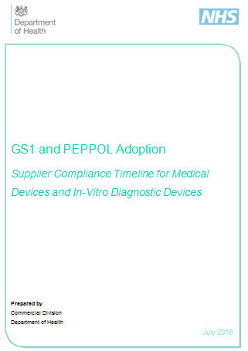
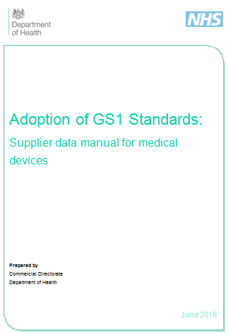
Published supplier guidance

Slide 9
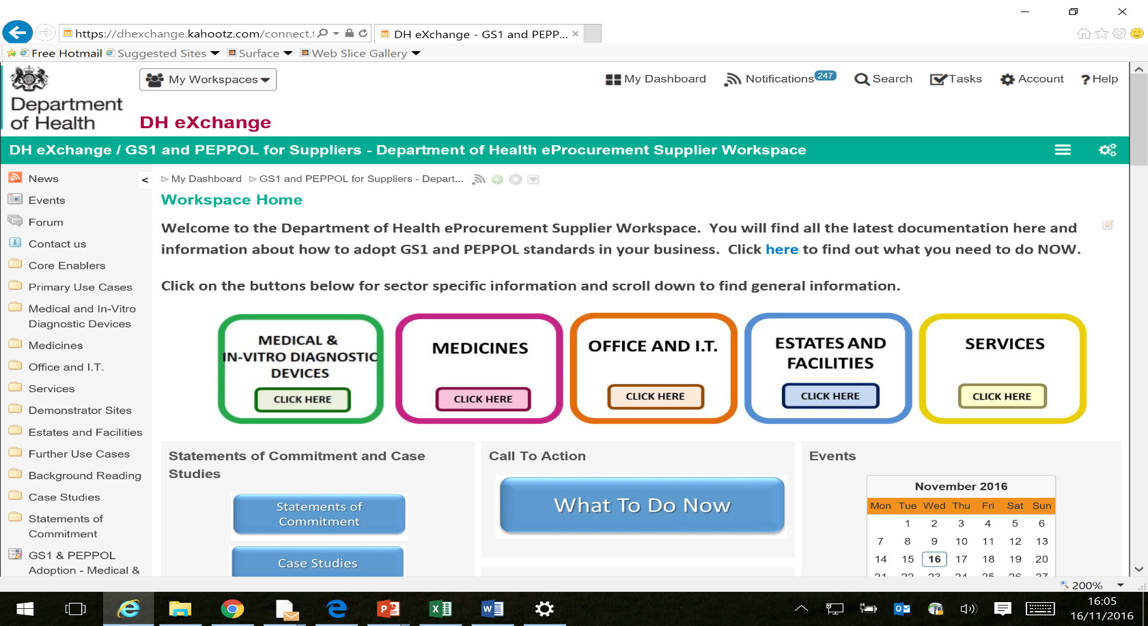
Supplier workspace now has c 650 members
email eProcurement@dh.gsi.gov.uk for access

Slide 10
Medical & In-Vitro Diagnostic Device suppliers
By now suppliers should have:
Joined GS1
Completed a Readiness Questionnaire
Sent us a Statement of Commitment
Joined a PEPPOL access point
Allocated GLNs
Allocated GTINs for Class III and IVD List A devices
Be ready for March
With GTIN level product attribute data
To join a datapool
To receive orders via PEPPOL from the NHS

